Slide 1
Tornadoes: Nature's Circle Pit
April’2021

Slide 2
Team Members
Brie Pfisterer
Ajinkya Bhonsle (AJ)
Ryan Strong
Sandeep Kolwalkar

Slide 3
Interesting facts
+1000
+1700
$2B-$3B
tornadoes per year in US
casualties per year in US
property loss per year in US

Slide 4
Data Set
Summary: This dataset was extracted from NOAA's National Weather Service and consists of elements that define the impact of tornadoes across the US region.
Type of Data:
Numerical variable: year, injuries, grade(mag),Lat, Lon, loss(property), width, length Categorical variable: StateName
Statement: The impact of tornadoes on the environment and human life is devastating and through our data we are showing how regions in the US are affected
Questions:
How many casualties have occurred in US in the past few years?
Which region in the US are affected by tornadoes?
What are the different grades of the tornadoes?
Which year had the most devastating financial crises due to tornadoes?

Slide 5






Tools
Data preprocessing
Convert to geojson
ETL
Data pipeline
Flask App
Visualization
Map displays

Slide 6
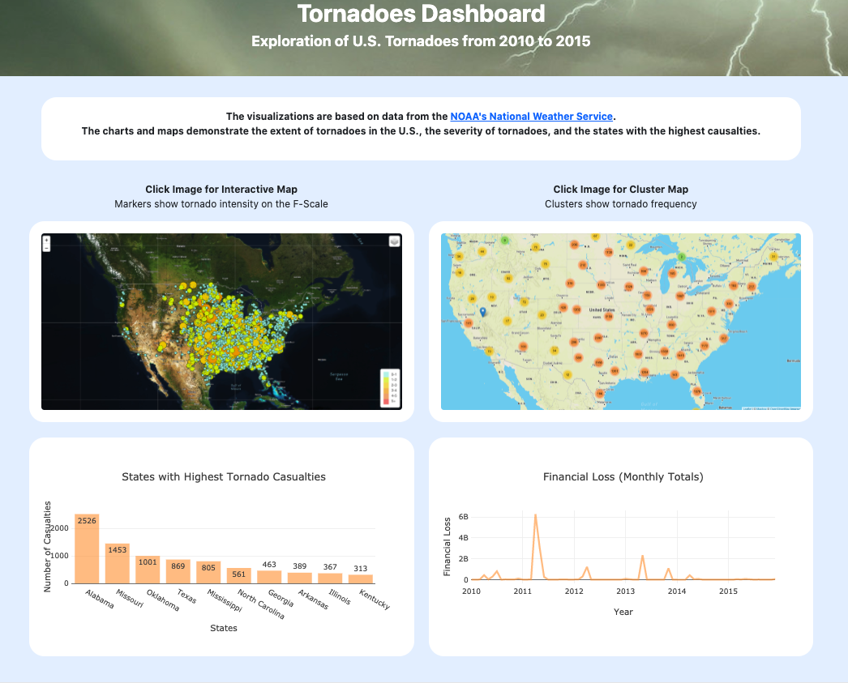
DEMO
Notes:
the surface winds come from the direction of the Gulf of Mexico, bringing in warm, moist air at the surface, and the winds aloft come from over the Rocky Mountains and are relatively dry.
the winds over the central part of the U.S are correct for making thunderstorms, they often bring together the right combination of the vertical temperature and moisture profile most likely to produce tornadoes.

Slide 7
Learnings
More tornadoes were observed in the mid-West and Eastern regions of US
Alabama had the most casualties across all US states
In 2011, there was a major tornado that hit 3 states (AL, MS, TN) with losses amounting to + $6B
Category EF4-5 tornadoes are mostly in mid-West

Slide 8
Next Steps
Show a growing trend (1950-toDate) of tornadoes, casualties, property loss to understand patterns
More filters(layers) to interactive map
Include more sources of weather and natural disasters

Slide 9
Thank You
Questions?

